Slide 1
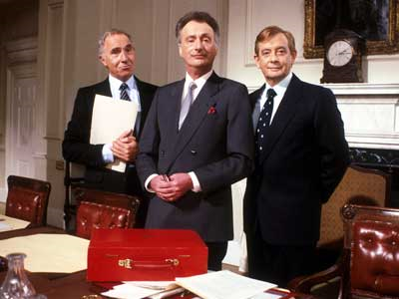
BRITISH POLITICAL SYSTEM

Slide 2
Introduction
the British – show little enthusiasm for politics
stereotypical view of politics: necessary evil, dirty business
politicians – regarded with suspicion; it is assumed that they are not telling the truth
Popular quote: Never trust anything until it has been officially denied.
In recent years, the public trust in politicians has dropped dramatically due to various corruption scandals (“cash for honours“ scandal under Blair, MPs expenses scandal under Gordon Brown)
> general disillusionment with institutions that were once considered the pillars of the liberal and democratic British systém > a crisis of the political establishment

Slide 3
BCKGROUND INFO
A key fact to the character of British politics > Britain has not been invaded and occupied since 1066 > development through gradual change and reform based on consensus, rather than through revolutionary events
A major feature > the British political system is not very neat or logical; much of it is based on custom and tradition; there is a great deal of pragmatism involved
There is no written constitution! Instead, three sources serve its purpose:
All the laws and decrees made over the centuries (Common Law)
The way these laws have been interpreted and re-interpreted in Law Courts
The way things have been done over the centuries, though not written down

Slide 4
Key developments
The main historical development > shift of power from an absolute monarch to a parliament increasingly representative of and accountable to the general population (the bicameral Parliament > from 14th century; a model to parliaments elsewhere)
Scotland, Wales and Northern Ireland > have their own representative assemblies with a wide range of powers
Since 1973 > membership of the EU > the Parliament is limited in some of its decision-making (European Convention on Human Rights and others)

Slide 5
US-UK difference
In the USA > the system of separation of powers (“checks and balances“)
The legislature – elected body that passing laws (Congress)
The executive – the Government runnig the country
The judiciary – the courts and judges making sure law is obeyed
In the UK:
all Cabinet ministers are simultaneously MPs
some senior judges a members of the House of Lords
the formal head of the judiciary is a senior minister

Slide 6
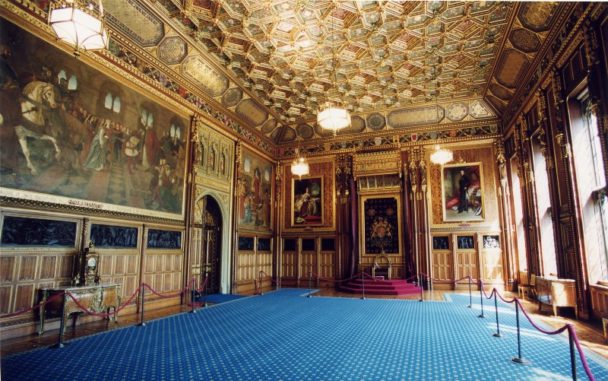
Corridors of Power
The style of politics – marked by the respect for privacy and secrecy
important decisions – not taken at large meetings, but at lunches, over drinks or accidental encounters in the corridors of power ➢ things decided before discussed officially

Slide 7
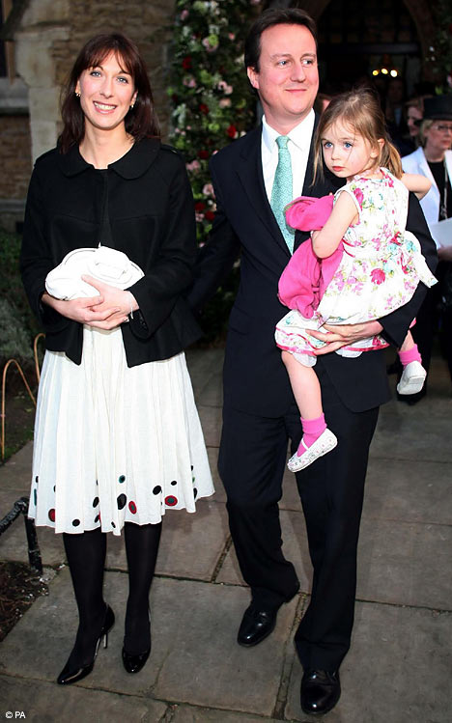
The party system - Conservatives
Conservatives (Tories) – centre-right at the moment (used to be right-wing, traditionally associated with middle and upper classes; now trying to embrace a wider political spectrum)
shared ideas: free market economy, minimal state, lower taxation, self-suffiency, emphasis on family and tradition, opposed to multiculturalism, eurosceptic, critical of the “broken society” of today’s Britain
at present -under the leadership of David Cameron – new emphasis on environmentalism and social policy (compassionate conservatism)

Slide 8
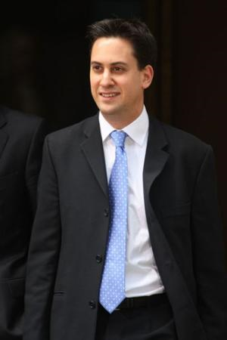
The party system - Labour
Labour (now called New Labour) – centre-left at the moment (originally, a Socialist party protecting the interests of the working class; now trying to embrace a wider political spectrum, especially the middle classes)
shared ideas – combination of free-marked economy and welfare state (“Third Way”), social justice, support of socially disadvantaged groups (minorities, single-parent families, the disabled, etc.) For a long time, support of multiculturalism and immigration (now under revision).
Previous leaders: Tony Blair, Gordon Brown; presently: Ed Milliband

Slide 9
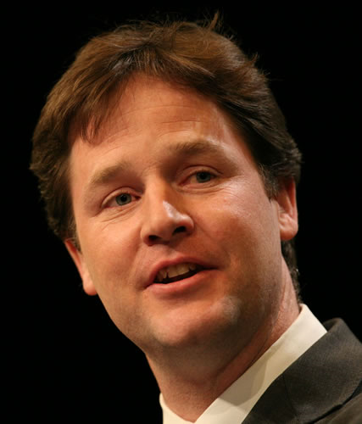
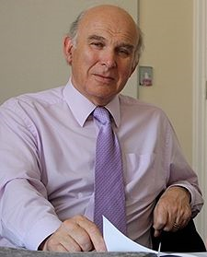
Smaller but important - LibDems
Liberal Democrats (LibDems) - originated in the 80s as a fusion of the Liberal Party and Social Democrats
Programme: social liberalism (civil liberties but welfare state); constitutional reform
At present, they are a member of the coalition government together with the Tories
Main personalities: Nick Clegg (leader), Vince Cable (Business Secretary)

Slide 10
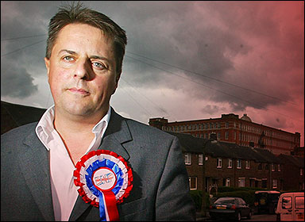

The “Bad Guys“ - the BNP
The British National Party (BNP) > an extreme right-wing party
Aim = to restore the “overwhelmingly white ethnicity of Britain that it says existed prior to 1948 through legal means“http://en.wikipedia.org/wiki/British_National_Party)
Currently – the party support grows; the supporters > working-class people disillusioned with the failure of mainstream parties to address their problems (mainly immigration) > “protest vote“

Slide 11
Her Majesty's Government
Broader government - all the politicians appointed by the monarch on the advice of the PM to help to run government departments >  about 100
Government in the narrow sense: the Cabinet (the PM and other ministers; about 20)
the Cabinet: traditionally single-party, based on collective responsibility; at present, however, there is a coalition (Conservatives and LibDems)
Most important ministers:
Foreign Secretary - Foreign Office
Home Secretary – Home Office
Chancellor of the Exchequer – Treasury

Slide 12
The Prime Minister
An office that emerged in the 18th century
First “official“ Prime Minister – Robert Walpole (1676 – 1745)
PM's position – in contrast to that of the monarch
officially – PM is just the foremost of HM´s political servants (primus inter pares) x in fact, he has great power (which has even increased since Tony Blair, often accused of a “presidential“ style of politics)
the Queen´s power of partonage (the power to appoint people to different jobs) – in fact the PM´s power of patronage
example : cabinet reshuffle – the PM changes his ministers (quite often)

Slide 13
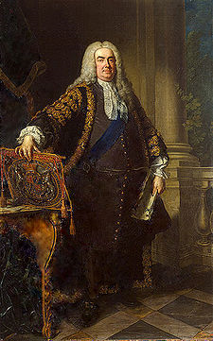
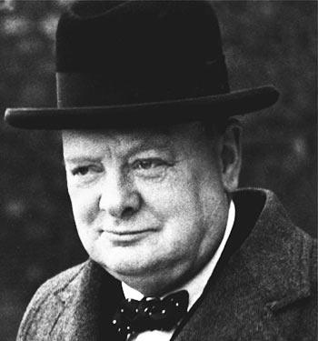
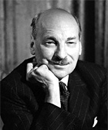
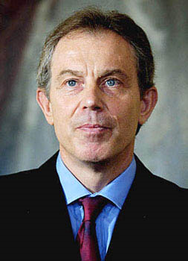
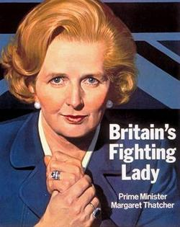
Some notable PMs

Slide 14
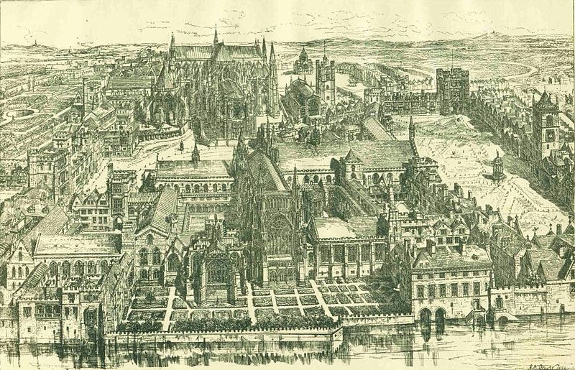
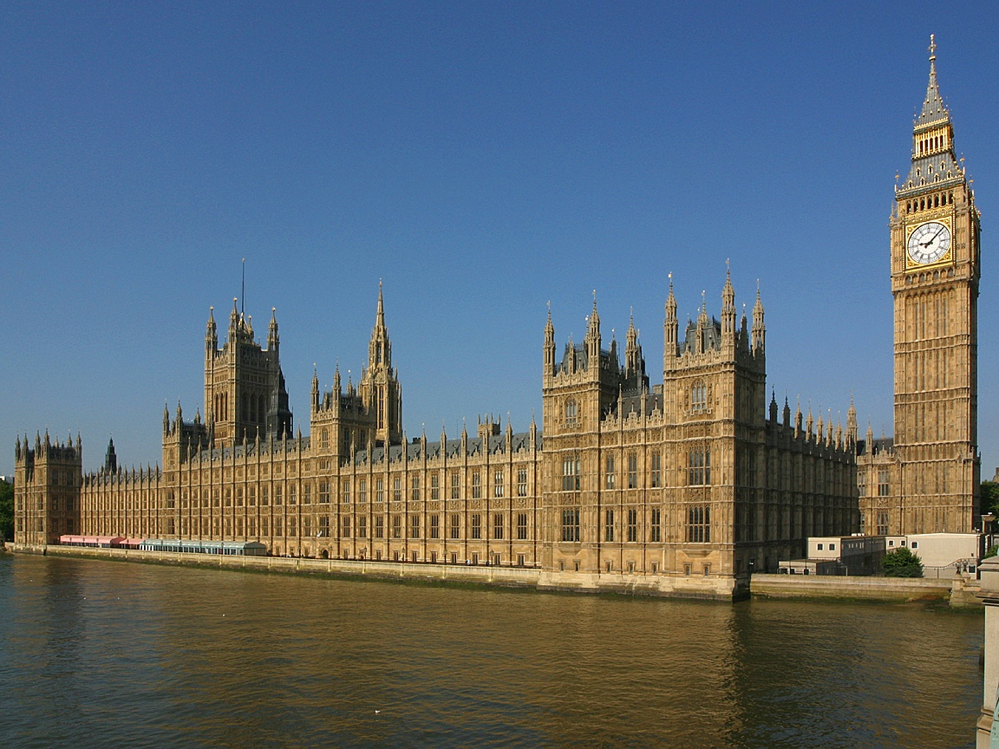
The Parliament

Slide 15
The Parliament
Situated in a building called the Palace of Westminster
Lower chamber > House of Commons (more important)
Upper chamber > House of Lords (lost its significance in the course of British history)
Besides the two chambers – the Palace also contains offices, committee rooms, restaurants, bars and libraries
The layout of the Palace … very complex and intricate, encouraging the privacy of the “corrirods of power“

Slide 16
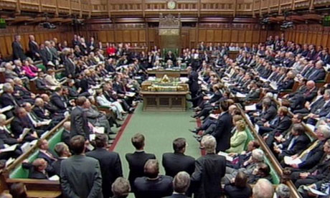
The House of Commons
The layout > different from the customary arrangement in other parliaments
Rather than a customary semi-circle, there are two rows of benches facing each other > governing party on one side, opposition on the other
The benches separated by the elevated Speaker's chair
Question for discussion: how does this arrangement reflect the British political reality?

Slide 17
The Speaker
“The Speaker of the House of Commons chairs debates in the Commons chamber. The holder of this office is an MP who has been elected to be Speaker by other Members of Parliament. During debates they keep order and call MPs to speak.
The Speaker is the chief officer and highest authority of the House of Commons and must remain politically impartial at all times. The Speaker also represents the Commons to the monarch, the Lords and other authorities and chairs the House of Commons Commission.
The Speaker is perhaps best known as the person who keeps order and calls MPs to speak during Commons debates.
The Speaker calls MPs in turn to give their opinion on an issue. MPs signal that they want to speak by standing up from their seat (a custom known as 'catching the Speaker's eye') or they can notify the Speaker in advance by writing.
The Speaker has full authority to make sure MPs follow the rules of the House during debates. This can include:
directing an MP to withdraw remarks if, for example, they use abusive language
suspending the sitting of the House due to serious disorder
suspending MPs who are deliberately disobedient - known as naming
asking MPs to be quiet so Members can be heard“ http://www.parliament.uk/about/mps-and-lords/principal/speaker/

Slide 18
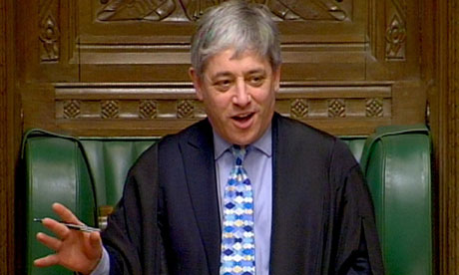
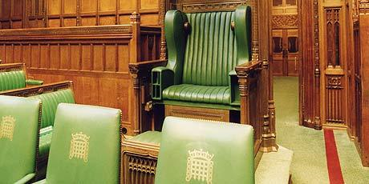
The Speaker II

Slide 19
Other features of the House of Commons
There are about 650 Mps, but only 400 seats
Mps don't have a fixed seat > they will sit anywhere, or even stand up >informality
They don't have their own desk > the lack of “private territory“ forces them to co-operate
Hansard > a daily word-for-word transcript of the day's Parliament business; published within 48 hours of the session (also available on the Internet > here: http://www.parliament.uk/business/publications/hansard/commons/)

Slide 20
An MP's Life
In the past, MPs were unpaid > not a “job“ but service to the public; in the 19th century – salaries introduced to stop only the rich becoming MPs
Even today, however, MPs are not paid as much as elsewhere in Europe; their facilities are also quite modest
Traditionally – the ideal of the MP as a “talented amateur“ (a person pursuing his own job while also serving in the Parliament); recently > more professionalization
The tradition is still reflected in the hours of business of the House > it meets in the afternoon and evenings, not in the morning; there are also long holidays
However, British MPs work very hard; they must be very active in their constituencies dealing with the issues of the people they represent
Often, the MP's job leaves very little time for family > high divorce rate of MPs

Slide 21
Party politics in the Parliament
Two groups of Mps:
Frontbenchers: members of the Cabinet or the Shadow Cabinet > they are seated at the front
Backbenchers: ordinary Mps, without a government post > sit at the back
Whips > intermediaries between frontbenchers and backbenchers; their task is to make sure the MPs for the particular party vote unanimously (unless a “free vote“ is allowed)

Slide 22
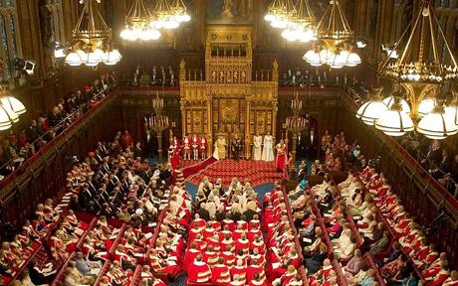
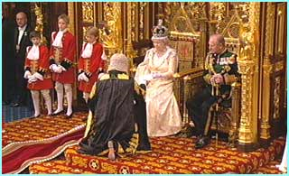
The House of Lords

Slide 23
The House of Lords
> a peculiar insitution unparalelled in other democracies
> the reason behinds its existence = tradition
The number of Lords – not fixed (around 750 now)
Historically, they were hereditary peers > inherited the office
They included aristocracy, senior Church officials and senior judges
In the 20th century > continuous effort to reform the upper chamber
At present = a majority are “life peers“ > their title cannot not be inherited
Often, they have been appointed for their achievements in the public domain (Margaret Thatcher, Andrew Lloyd Weber, P.D. James …)
At present > a reform movement to have the House of Lords wholly elected

Slide 24
The function of the Lords
The primary purpose > to scrutinize and debate bills proposed by the Commons and suggest amendments to them
The legislative power of the Lords is very limited (basically, they can only delay bills)
Until 2009 – they served as the court of last resort (judicial function) > this has now been taken over by the Supreme Court of the UK
Questions for discussion:
1. Do you think there is any point in keeping the House of Lords? Does it have any positive role at all?
2. Do you agree that the Lords should be completely elected? What would be the advantages/disadvantages?

Slide 25
Questions for discussion
How do you think a British MP's life differs from the life of a Czech MP?
What disadvantages can the increasing professionalization of MPs involve?
Why do you think there are still so few women MPs in the British Parliament?

